Slide 1




INTERNSHIP/PROFESSIONAL PRACTICE
TOPIC:CISCO NETWORKING
Training centre: ATME COLLEGE OF ENGINEERING
Under the guidence of:
External guide:
KIRAN B
Trainer
Internal guide:
Dr. SATHISH K R ME, Ph.D.
Assistant Professor
EEE dept. ATMECE
Presented by:
MADHU GOWDA H K
4AD18EE015

Slide 2
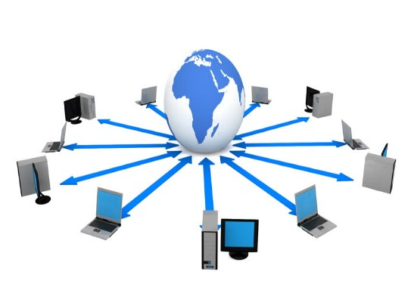
CONTENTS
INTRODUCTION
OBJECTIVES
NETWORK AND ITS TYPES
DEVICES USED
TYPES OF ETHERNET CABLES
CISCO PACKET TRACER
CASE STUDY
ADVANTAGES AND APPLICATIONS
OUTCOME
CONCLUSION

Slide 3

INTRODUCTION
CCNA stands for Cisco Certified Network Associate and it is one of the two most popular network-related certifications provided by Cisco Systems.
Cisco Systems was founded in December 1984 by Sandy Lerner and Len Bo sack, a director of computer facilities for the Stanford University Graduate School of Business.
Cisco provides IT products and services across five major technology areas: Networking, Security, Collaboration, Data Centre, and the Internet of Things.
Further it has been established as Cisco Networking Academy in 1997.

Slide 4
OBJECTIVES
To describe the devices and services used to support communications in data networks and the internet.
To describe the importance of addressing and naming schemes at various layers of data networks in IPv4 and IPv6 environments.
To design, calculate, and apply subnet masks and addresses to fulfil given requirements in IPv4 and IPv6 network.
To build a simple Ethernet network using routers and switches.
Use Cisco commands-line interface (CLI) commands to perform basic router and switch configuration.

Slide 5
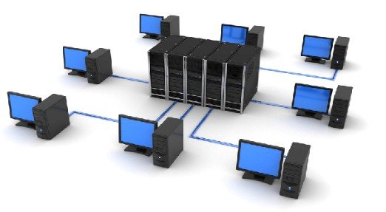
NETWORK
A Network consists of 2 or more computer connected together and they can communicate and share resources.
Resources such as files, applications, printers and software are common information shared in a networking scenario.

Slide 6
TYPES OF NETWORK
LAN
WAN
MAN
PAN
Local Area Network
Wide Area Network
MetroPolitan Area Network
Personal Area Network

Slide 7
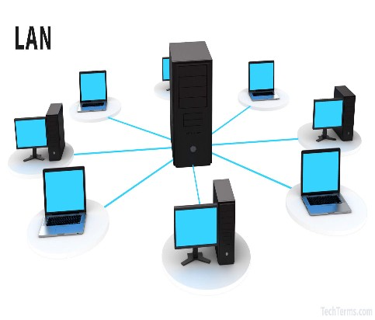
LOCAL AREA NETWORK(LAN)
LAN is a network which is designed to operate over a small physical area such as an office, factory or a group of buildings.
LAN’ s are easy to design and troubleshoot.
Exchange of information and sharing of resources becomes easy because of LAN.
In LAN all machines are connected to a single cable.
Different types of topologies such as star, tree, bus, ring, etc can be used.
It is usually a privately owned net.

Slide 8
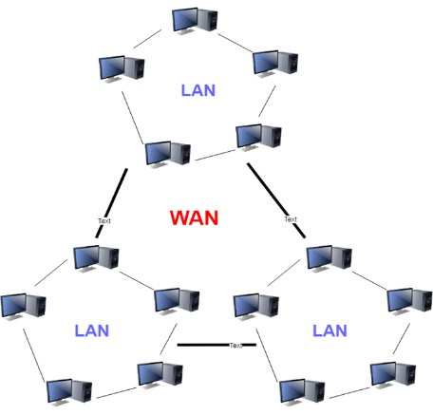
WIDE AREA NETWORK(WAN)
When network spans over a large distance or when the computers to be connected to each other are at widely separated locations a local area network cannot be used.
Hence a wide area network (WAN) is installed.
The communication between different users of WAN is established using leased telephone lines, satellite links and similar channels.
It is cheaper and more efficient to use the phone network for the link.
Most WAN networks are used to transfer large blocks of data between its us.

Slide 9

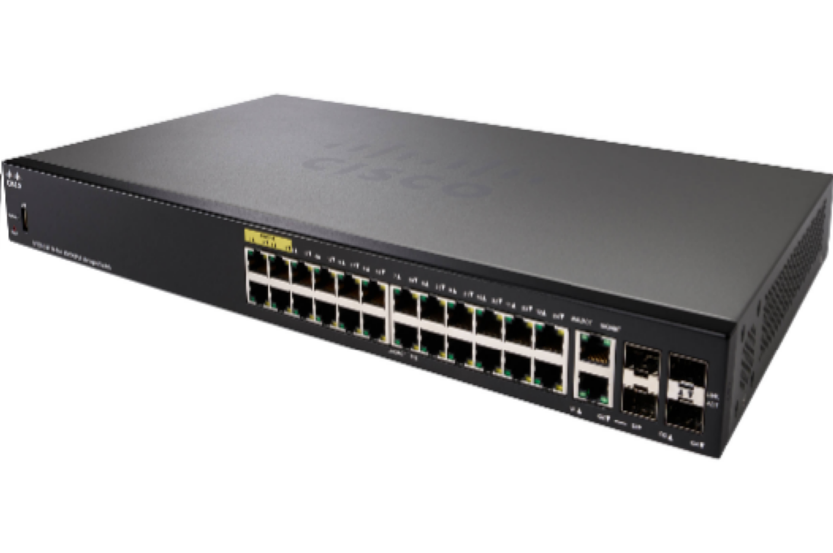
DEVICES USED
Switch: A network Switch is a hardware device that connects devices on the network by using packet to receive and forward data to the destination device.
PC: It is a computer which are intended to be operated directly by a user.

Slide 10
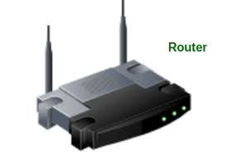
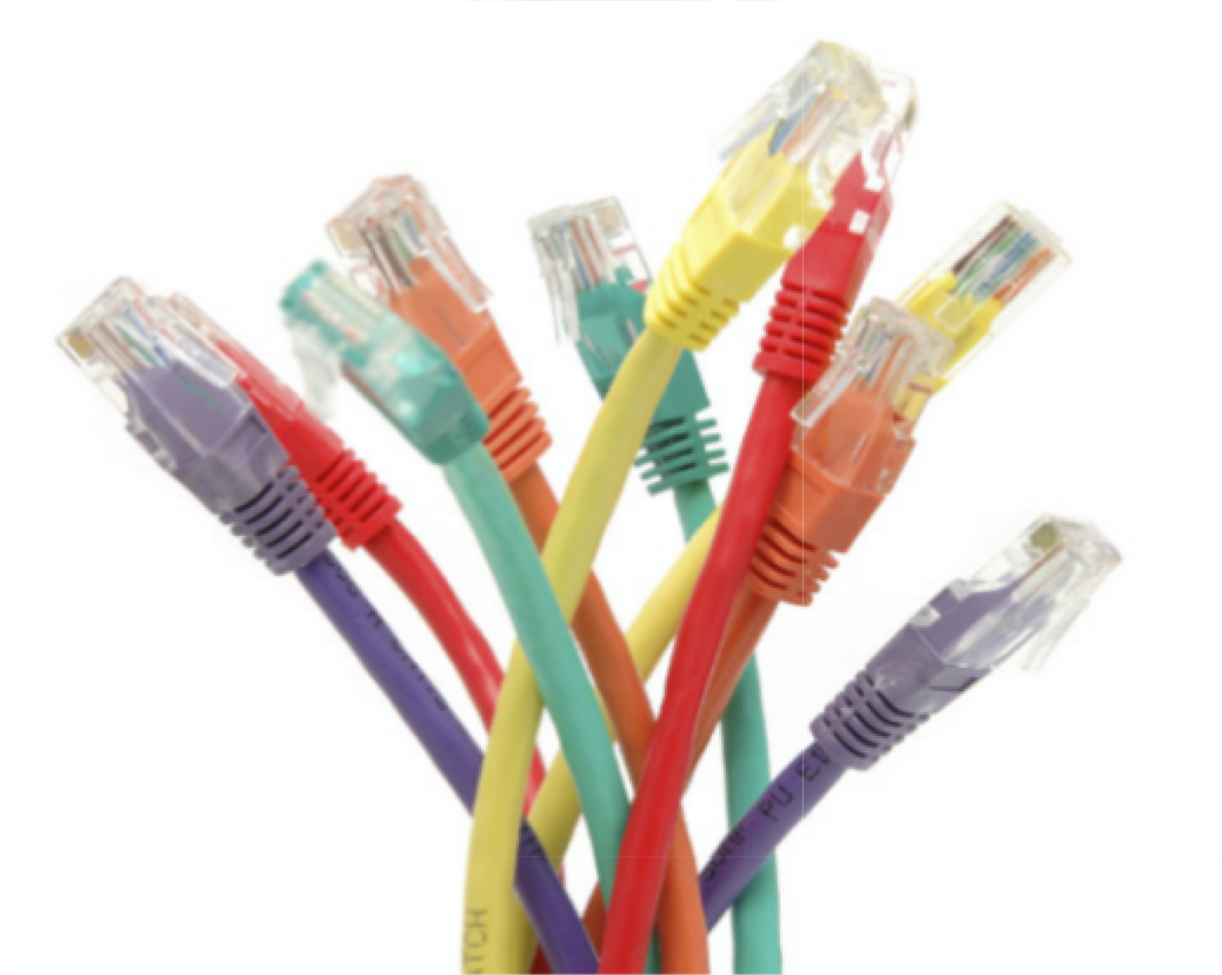
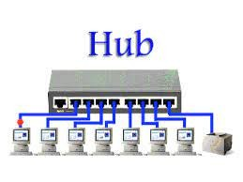
Router: A Router is a networking devices that forwards data packets between computer networks.
Network Cable: These hardware used to connect one network device to other network devices or to connect two or more computers to share a common printer or a scanner.
Hub: A hub is a physical layer networking device which is used to connect multiple devices in a network. They are generally used to connect computers in a LAN.

Slide 11
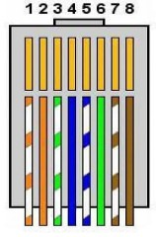
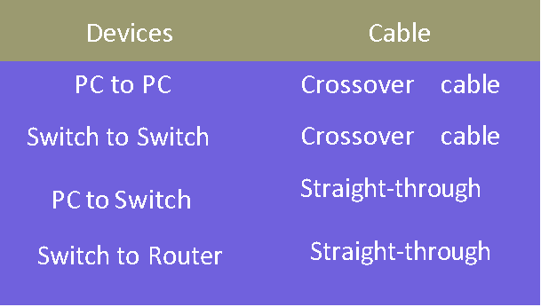
TYPES OF ETHERNET CABLES
Straight through cable:This type of cable has identical wiring on both ends
Cross over cable:The wire pairs are swapped in this type
ETHERNET CABLES

Slide 12
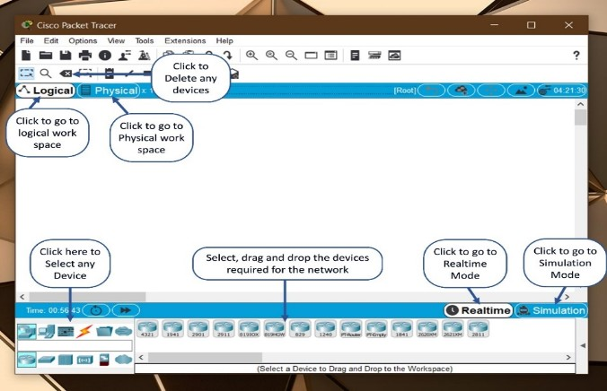
CISCO PACKET TRACER
Packet Tracer is a visual simulation tool designed by Cisco System that allows users to create network topologies and imitate modern computer networks.
Packet Tracers uses a drag and drop interface. This allows users to add and remove network devices as per the design.

Slide 13
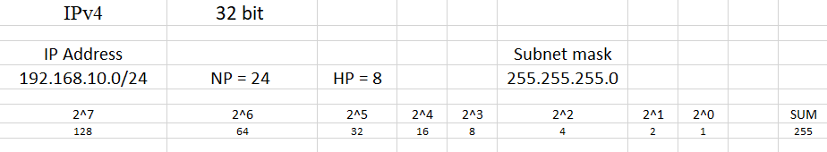
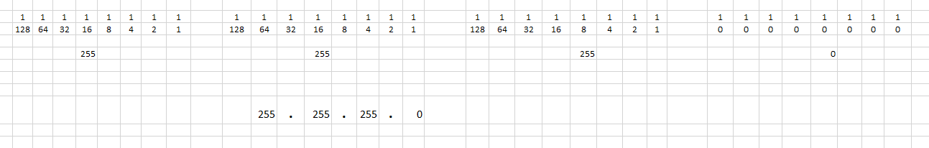
CALCULATION OF SUBNET MASK

Slide 14
CASE STUDY
8.1.4.7 Packet Tracer – Subnetting Scenario
Scenario
In this activity, given the network address of 192.168.100.0/24 to subnet and provide the IP addressing for the network shown in the topology. Each LAN in the network requires enough space for, at least 25 addresses for the end devices, the switch and the router. The connection between R1 to R2 will require an IP address for each end of the link.
Objectives
Part 1: Design an IP Addressing Scheme
Part 2: Assign IP Addresses to Network Devices and Verify Connectivity

Slide 15
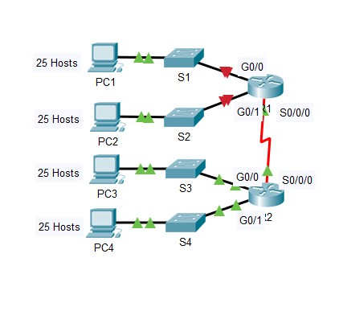
Topology

Slide 16
Part 1: Designing the IP Addressing Scheme
Step 1: Subnetting the network 192.168.100.0/24 into the appropriate number of subnets. Based on the topology only 5 subnets are required, but this create up to 8 subnets. Let us split the network address 192.168.100.0 as per Topology. The topology requires 25 address.
Subnet 0 Ip Address Binary Representation
Subnet Address 192.168.100.0 11000000.10101000. 01100100.00000000
Broadcast Address 192.168.100.31 11000000.10101000. 01100100.00011111
Subnet mask 255.255.255.224 11111111.11111111. 11111111.11100000

Slide 17
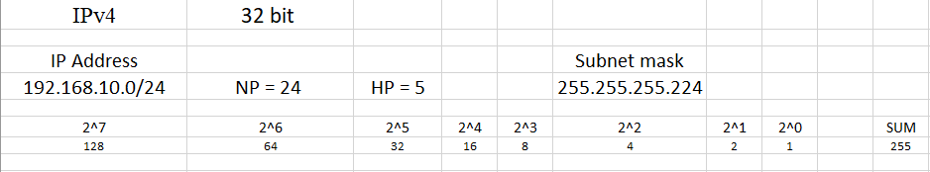
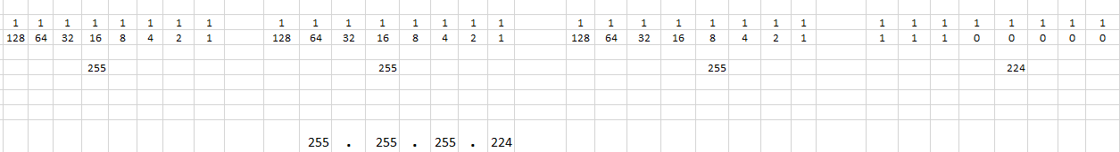
CALCULATION OF SUBNET MASK

Slide 18
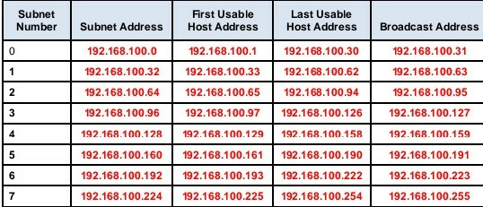
SUBNET TABLE:

Slide 19
Addressing Table for the Topology
Step 2: Assigning the subnets to the network shown in the topology.
Assigning Subnet 0 to the LAN connected to the Gigabit Ethernet 0/0 interface of R1
Assigning Subnet 1 to the LAN connected to the Gigabit Ethernet 0/1 interface of R1
Assigning Subnet 2 to the LAN connected to the Gigabit Ethernet 0/0 interface of R2
Assigning Subnet 3 to the LAN connected to the Gigabit Ethernet 0/1 interface of R2
Assigning Subnet 4 to the WAN link between R1 to R2
Step 3: Documenting the addressing scheme. Filling in the Addressing Table using the following guidelines:
Assigning the first usable IP addresses to R1 for the two LAN links and the WAN link.
Assigning the first usable IP addresses to R2 for the LANs links. Assign the last usable IP address for the WAN link.
Assigning the second usable IP addresses to the switches.
Assigning the last usable IP addresses to the hosts.

Slide 20
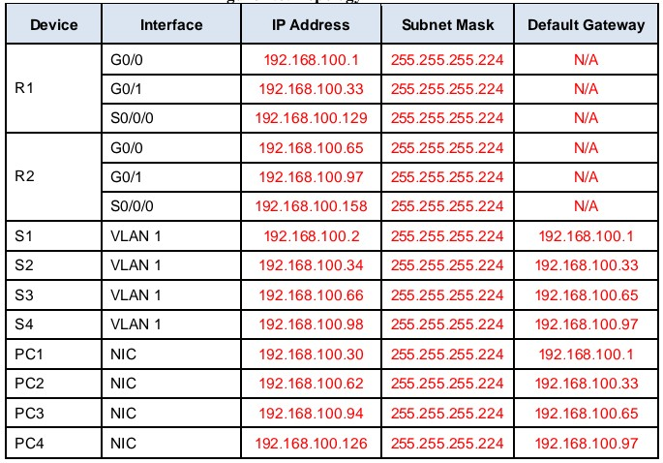
Addressing Table for the Topology

Slide 21
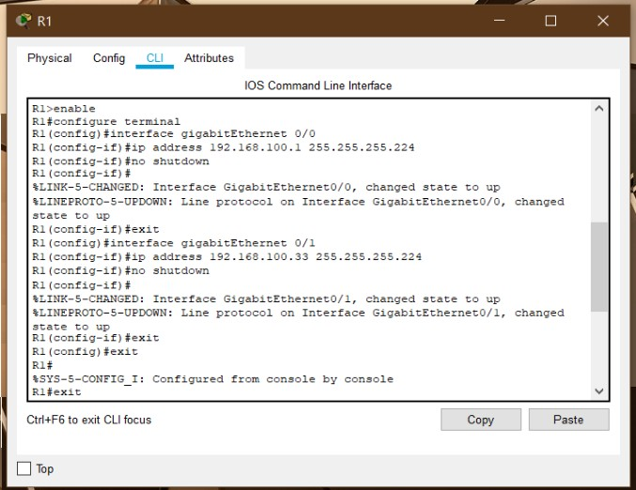
Part 2: Assigning IP Addresses
Step 1: Configuring IP addressing on R1 LAN interfaces.

Slide 22
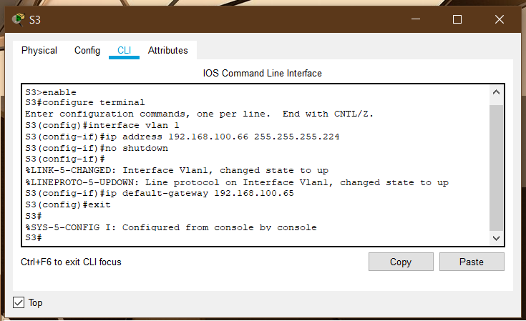
Step 2: Configuring IP addressing on S3

Slide 23
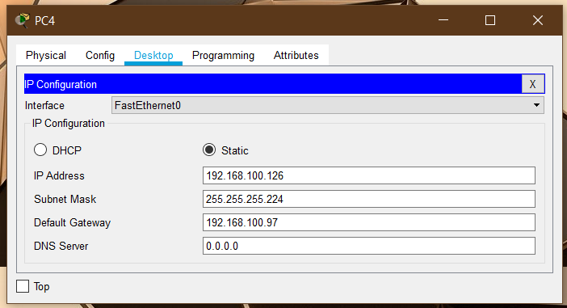
Step 3: Configuring IP addressing on PC4

Slide 24
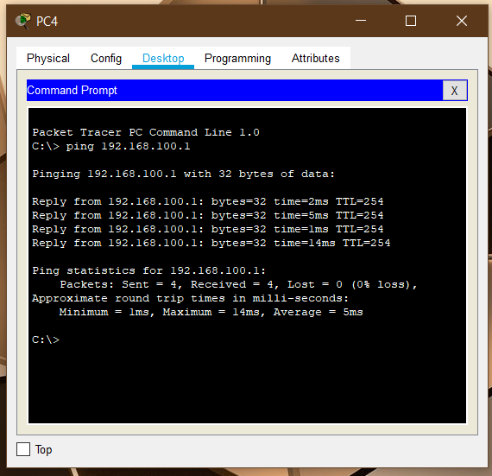
Step 4: Verifying connectivity

Slide 25
ADAVANTAGES
Resource sharing
High reliability
Easy communication
Speed
Communication medium
Hardware sharing

Slide 26
APPLICATIONS
Electronic mail
Video conference
Electronic data interchange
Electronic fund transfer
Distance learning
Telecommunication

Slide 27
OUTCOMES
This Internship has let me gain knowledge of designing a network. Its gives the introduction to the structure, components and models of computer networks. The following task were performed during the internship:
To build a simple a network using routers and switches.
Learnt about the importance of addressing in a network.
To perform initial configurations on the network devices.
To design subnet masks and addresses to fulfil given requirements in a network.
Types of Ethernet cables and its colour codes.
To secure lines and networking devices using passwords.
To verify connectivity between a host to host and network to network.

Slide 28
CONCLUSION
At the end of the Internship, I was able to:
Build simple LANs, perform basic configurations for routers and switches, and implement IPv4 and IPv6 addressing schemes.
Configure routers, switches, and end devices to provide access to local and remote network resources and to enable end-to-end connectivity between remote devices.
Develop critical thinking and problem-solving skills using real equipment and Cisco Packet Tracer.
Configure and troubleshoot connectivity a small network using security best practices

Slide 29
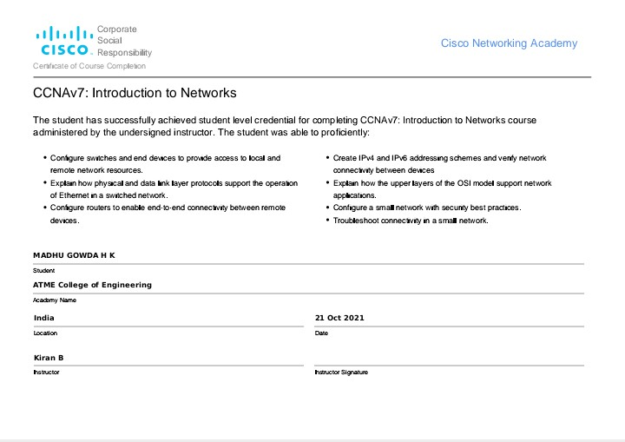
CERTIFICATE OF INTERNSHIP

Slide 30
THANKYOU

